Slide 1
EE 691-X : Fundamentals of Semiconductor Package Manufacturing & Test
Thermal Management
Instructor :
Micron Team
Prof. Nihar Ranjan Mohapatra Prof. Tarun Kumar Agarwal IIT Gandhinagar
Presenter :
Pradyumna Pandey 22250024
Navin Maheshwari 23210063

Slide 2
MOTIVATION
Electronic products generate heat from semiconductor switching and high current flow, impacting electrical performance and reliability.
Thermal management is vital to keep temperatures below 85°C, ensuring optimal performance and reliability, especially in silicon chip modules.
Effective thermal dissipation relies on materials, interfaces, and geometries in packaging design.
High-performance computers consume 200–500 W, which requires efficient thermal management.
Maintaining low temperatures prevents degradation and ensures package integrity.
Proper thermal management is essential for optimizing electrical performance and reliability in the systems.

Slide 3
Study of a Thermal Management
Thermal Transport Mode
Conduction
Convection
Radiation

Slide 4
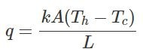
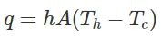
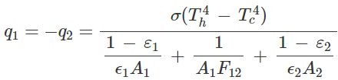
Study of a Thermal Management
Conduction : It is the transfer of heat from higher to lower temperature by random molecular interactions. It is the primary mode of heat transfer near the chip level.
Convection : Convection is the transfer of heat between the surface of a body and a fluid in motion adjacent to the surface, through a combination of random molecular interactions and the movement of the fluid. It is the primary mode of heat transfer to reject heat from the top of the electronics package.
Radiation : Radiation is the transfer of heat from the surface of a body in the form of EM waves. It often has a small or negligible impact on terrestrial electronics thermal management. But for some applications particularly consumer smartphones or in electronics used in spacecraft, radiation can strongly impact or even dominate heat transfer.

Slide 5
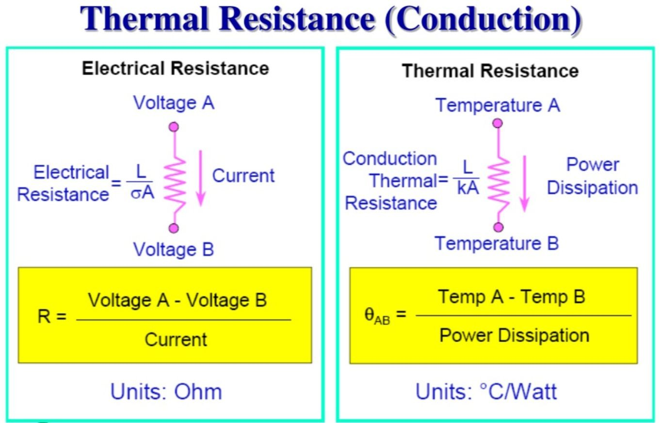
Electrical Analogy for Thermal Transport

Slide 6
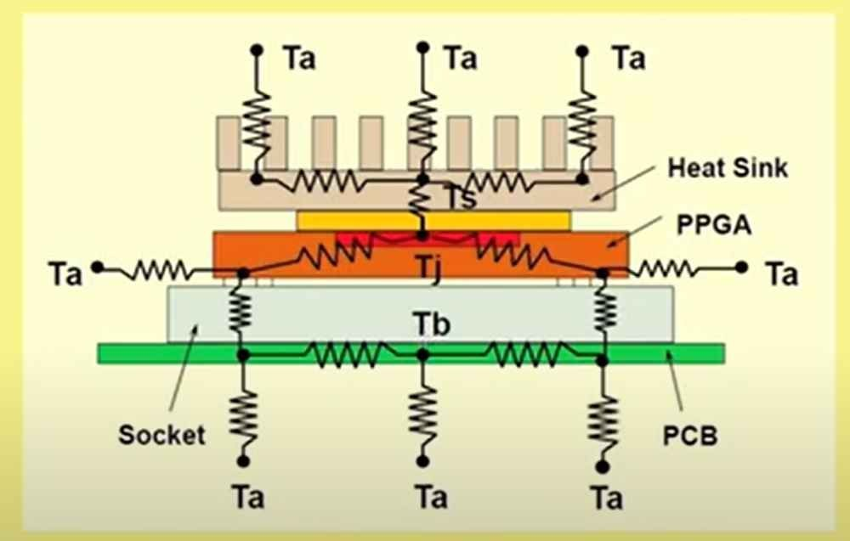
Thermal Resistance Network
The equivalent model of the thermal resistance within the chip is shown in figure.
Ta: Ambient Temperature
Tj: Junction Temperature
Tb: Baseline Temperature
Ts: Heat Sink Temperature

Slide 7
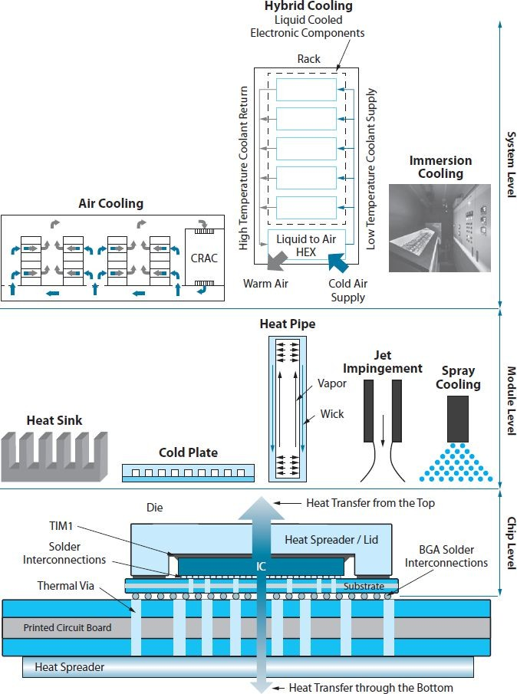
Levels of Thermal Management
3 levels of Thermal Management of an IC :
1. Chip Level
2. Module Level
3. System Level
13

Slide 8
Chip Level Thermal Technologies

Slide 9
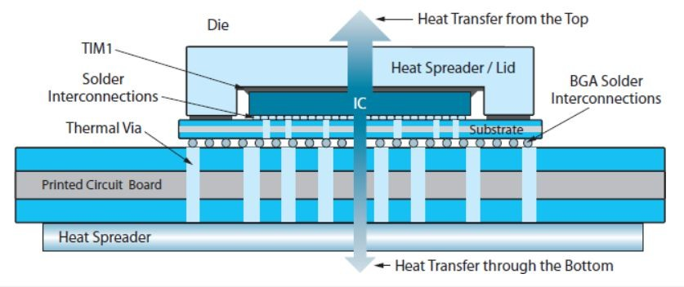
The Thermal Technologies to manage the heat at the chip level :
TIM : Thermal Interface Materials
Heat Spreaders
Thermal Via
At the chip level, heat dissipation primarily relies on “Conduction” due to the solid nature of the chip.

Slide 10
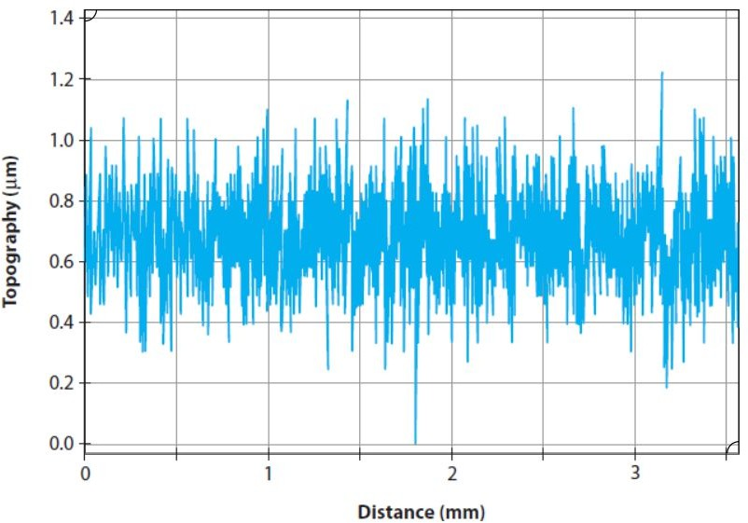
TIM : Thermal Interface Materials
TIM (conductivity more than air, 0.027 W/m.K) used as the interfaces between mating interfaces, such as those between the chip and lid or between the lid and the heat sink, in order to decrease Contact Resistance.
Although the chip or lid surfaces appear smooth, a microscopic examination of the surfaces shows characteristic roughness(about 0.5–1.25 microns) profile as shown in figure.
The lids may also have non-flat shapes due to stamping and machining operations. Thus, the TIM bondline profile from the center to the corner of the chip is not uniform.
Examples of TIM : Gels, greases, adhesives, and Indium solder, graphite.
Figure : Copper lid roughness along a 3-4 mm line on its surface

Slide 11
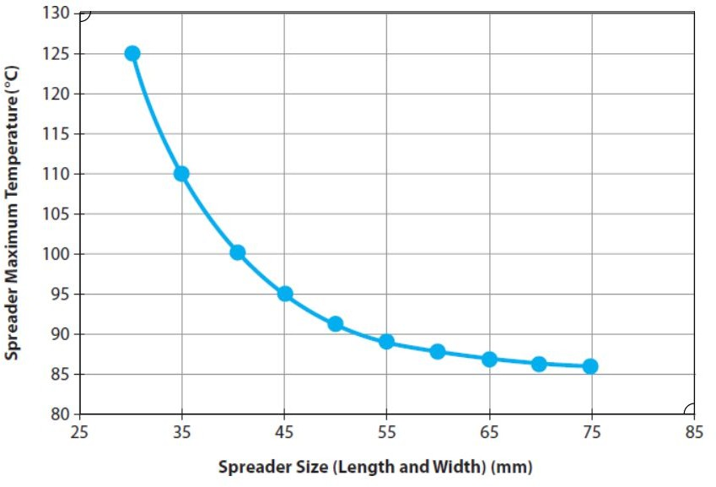
Heat Spreaders
Heat Spreaders are used to spread the heat dissipated in the chip to a
larger surface area before the heat is transmitted into a heat sink.
Heat spreaders enhance package rigidity, diminishing warpage and
safeguarding the package during assembly and operation.
As the spreader size is increased, the maximum spreader temperature decreases as shown in graph.
Material used for Heat Spreader :
Aluminum
Copper
Graphite etc.

Slide 12
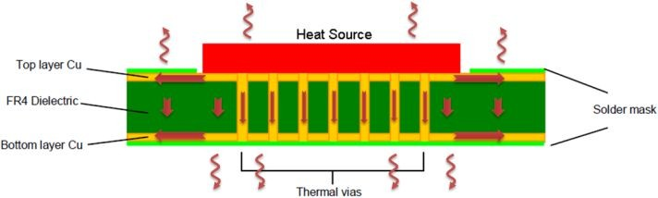
Thermal Vias
Thermal vias are used to transport heat away from the device.
Vias are usually used as electronic through-connections.
They can perform simultaneous electrical and thermal functions.
These structures can be either
Filled (preferable from a performance standpoint)
Capped or unfilled (preferable from a cost perspective)

Slide 13
Levels of Thermal Management
3 levels of Thermal Management of an IC :
1. Chip Level
2. Module Level
3. System Level
13

Slide 14
Module Level Thermal Technologies

Slide 15
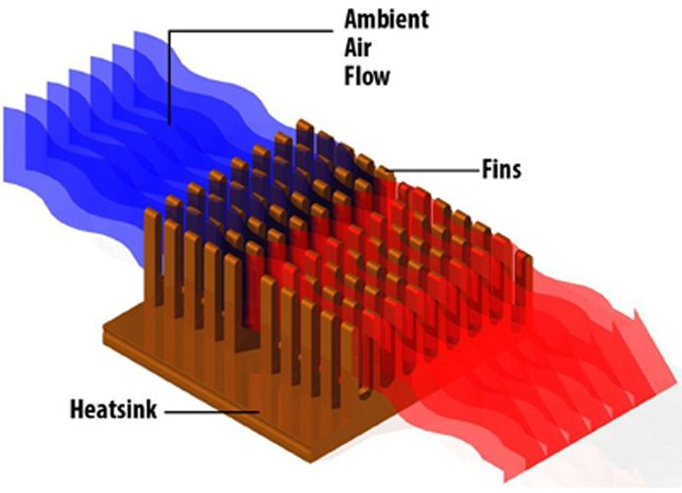
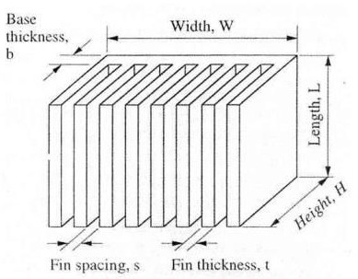
Heat Sinks
Heat is lost to the ambient environment through convection and radiation. Heat spreaders help distribute heat over a larger area before dissipating it to the surroundings.
Newton's Law of Cooling: Q_{conv} = h.A.ΔT (ΔT = Ts − T∞)
Hence, thermal resistance associated with surface convection is given by: R_{conv}= 1/(hA)
Metals used (excellent thermal conductivity) such as diamond, copper and aluminum (lower costs)
A heatsink can be optimized by varying different dimension shown.

Slide 16
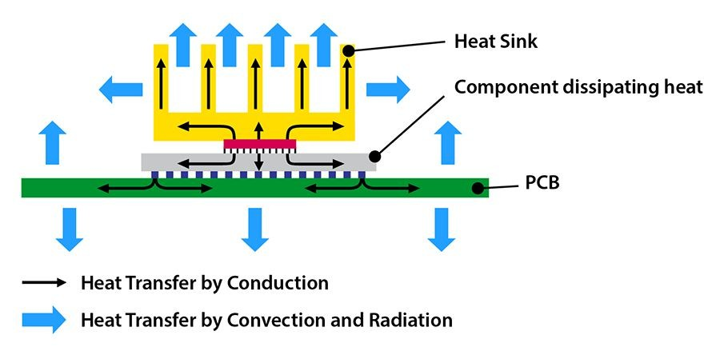
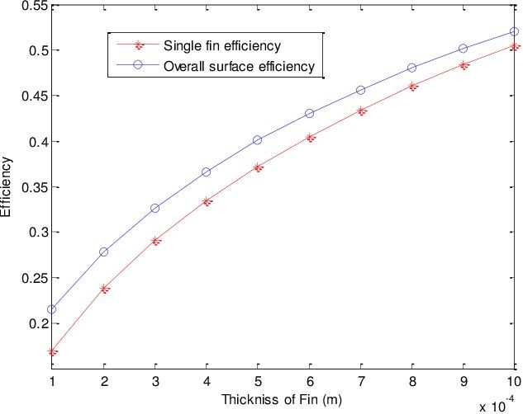
Heat Sinks
Fan Law:
Air flow ∝ n
Pressure drop ∝ n²
Noise ∝ n³
Fin Efficiency: Ratio of the actual heat transfer from the fin to that the heat that would be dissipated if whole surface of the fin is maintained at base temperature.

Slide 17
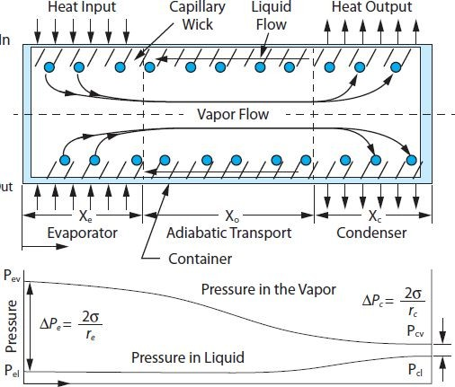
Heat Pipes and Vapor Chambers
A heat pipe consists of three key elements:
Working Fluid: The fluid that transfers heat.
Wick: Provides capillary action for fluid movement.
Enclosure Wall: Typically made of conductive material (e.g., copper).
Capillary Pressure Difference:
The condensed liquid returns to the evaporator within the wick due to capillary pressure difference.
The difference in radii or curvature at the condenser and evaporator ends sets up the capillary pressure difference.
Curved interfaces between vapor and liquid at wick pores contribute to this pressure difference.

Slide 18
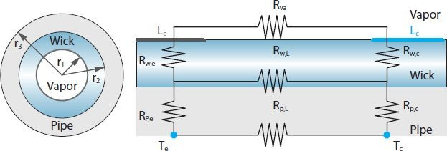
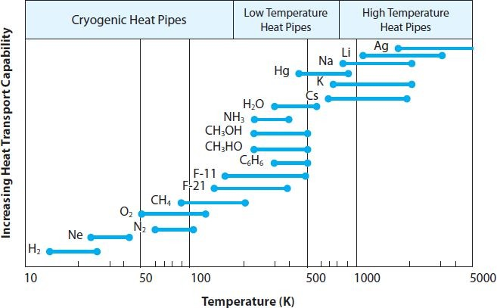
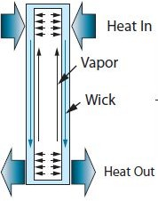
Heat Pipes and Vapor Chambers
Heat pipe working fluid choices for varying heat transport capabilities and operating temperatures.
Thermal resistor network for a circular cross-section of heat pipe.

Slide 19
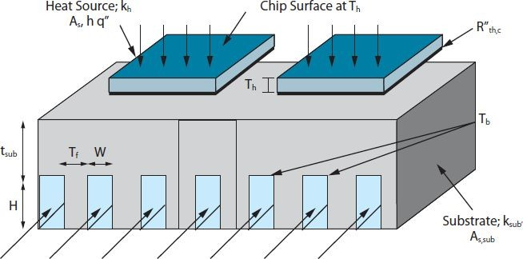
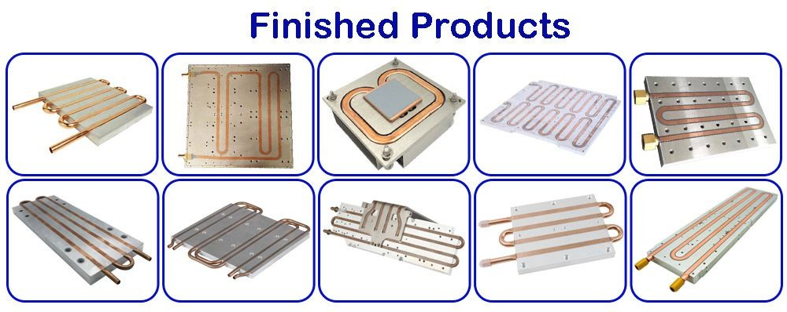
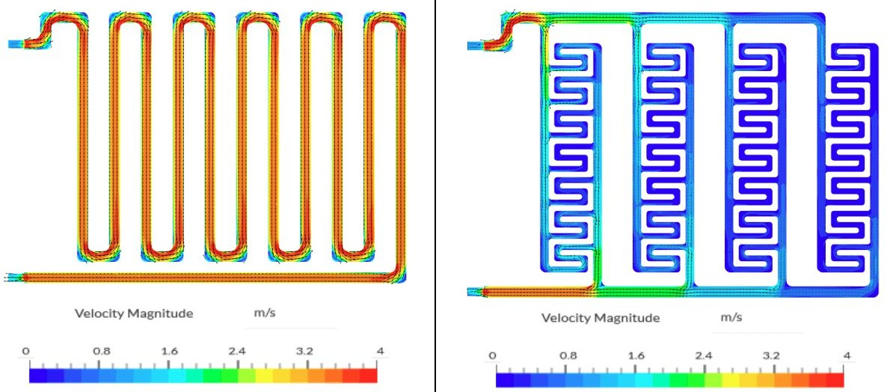
Cold Plates
Heat removal in high power dissipation applications like power electronics, radar modules, and avionics
Single pass/Multiple pass through the cold plate as a internal heat transfer enhancement features
Dissipated heat is conducted into the cold plate structure and carried away by convection mechanism to ambient environment.
Circulating fluid used in cold plates is water (or glycol/water)

Slide 20
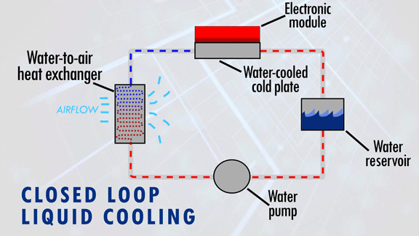
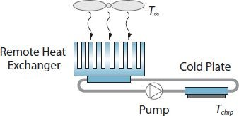
Closed-Loop Liquid Cooling
Used when heat dissipation ranges in 100-500 W.
When air-cooled heat sink sizes become impractical for compact server boxes.
Fails to provide sufficient air flow rates within these enclosures.
System Components:
Cold Plate: Compact component in direct contact with the heat source.
Remote Heat Exchanger: Larger air-cooled heat sink.
Pump: Facilitates liquid circulation.
Filter: Removes particulates

Slide 21
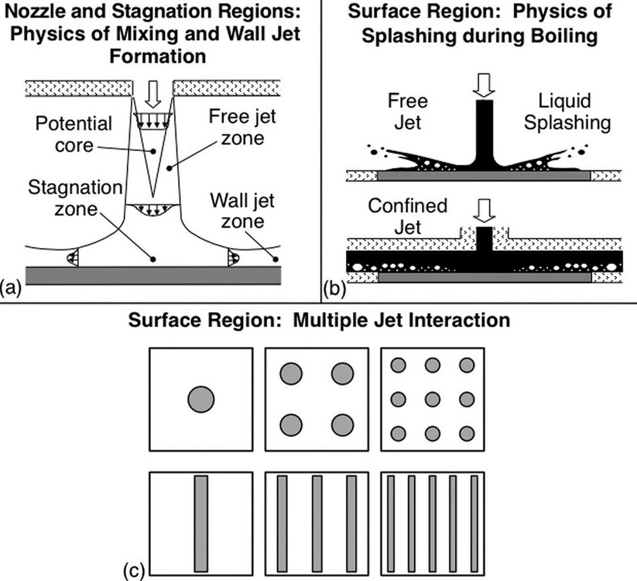
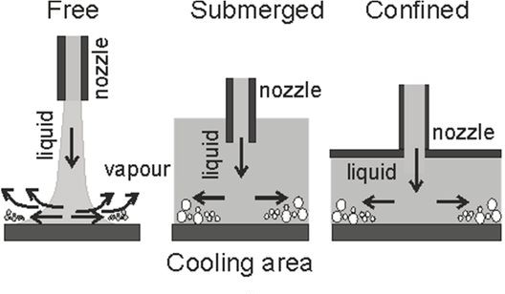
Jet Impingement Cooling
Directed flow of gas or liquid over a heated surface
Suitable for compact hardware systems
Larger surface area coverage
Requires lower flow rates compared to conventional cooling methods.
Impinging jets can handle heat fluxes in the range of 200 W/cm² using glycol-water jets.

Slide 22
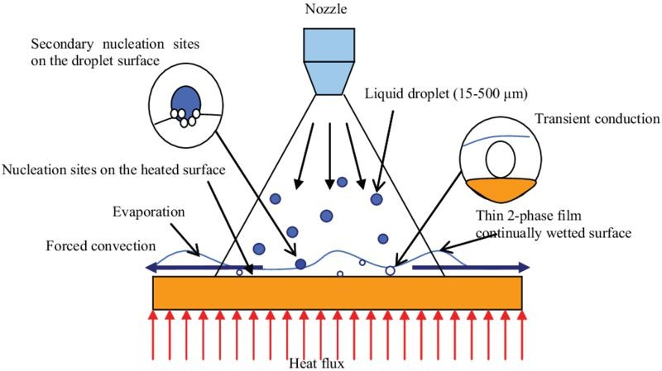
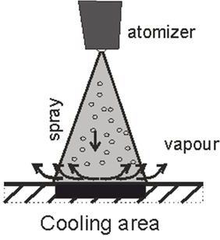
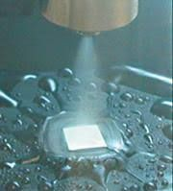
Spray Cooling
Liquid forced breaks up into fine droplets when passed through a small gas atomizing nozzle
These droplets impact the surface to be cooled
Heat transfer coefficients are higher than in pool boiling due to efficient vapor removal.
High scalability, low droplet impact velocity, and no surface temperature overshoot
Requires pumps, nozzles (circular, square, or oval), filters, and a condenser for closed-loop operation
Nozzles are arrayed to increase cover areas over system

Slide 23
Levels of Thermal Management
3 levels of Thermal Management of an IC :
1. Chip Level
2. Module Level
3. System Level
13

Slide 24
System Level Thermal Technologies

Slide 25
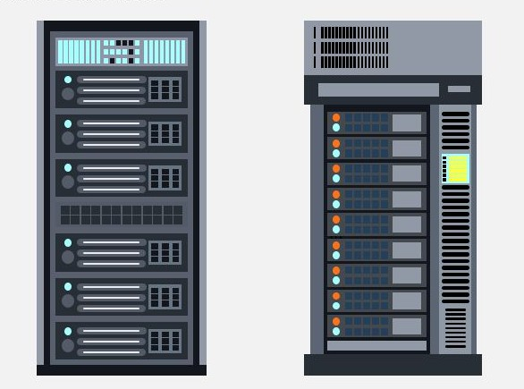
Data Centres: System-Level
Data Centers: These devices rely on data centers, which are facilities at the heart of cloud-based operations. Data centers come in various sizes and house IT hardware like servers, storage units, and switches.
Energy Consumption: Data centers require significant electrical power (tens of megawatts) to operate and manage heat dissipation.
Thermal Management: Data centers use air cooling for lower power dissipation (up to 15 kW per cabinet) and liquid cooling for higher power levels.

Slide 26
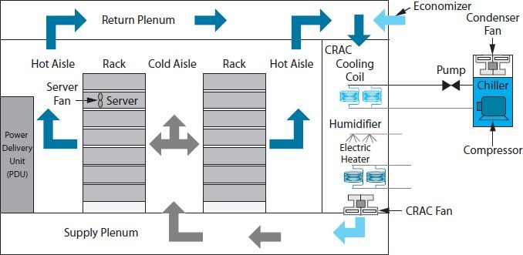
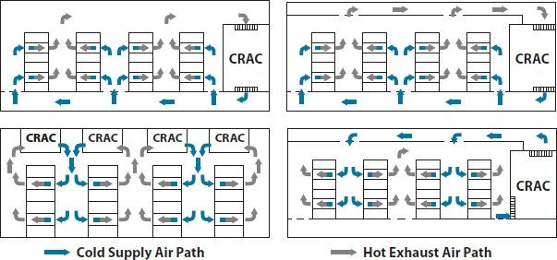
Air-Flow
Segregated hot and cold aisles
Computer room air-conditioning (CRAC) units flow into the cold aisles
Cold air flowed over IT components, hot air is discharged into the adjacent hot aisle
Ensuring proper air-flow delivery is crucial for thermal management
Localized hot spots formation leads to
equipment failure.
American Society of Heating Ventilation and Air Conditioning (ASHRAE) defines environmental envelopes for operation.

Slide 27
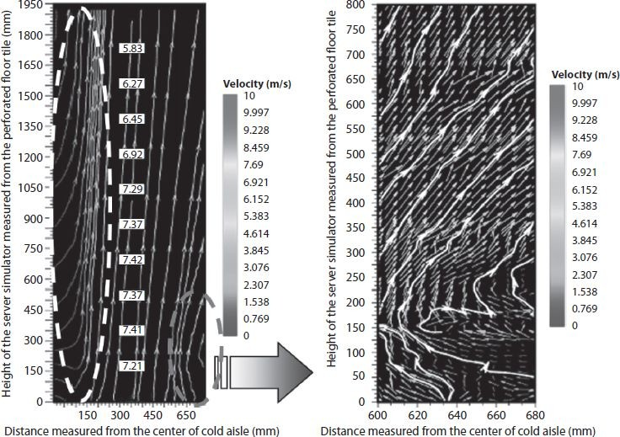
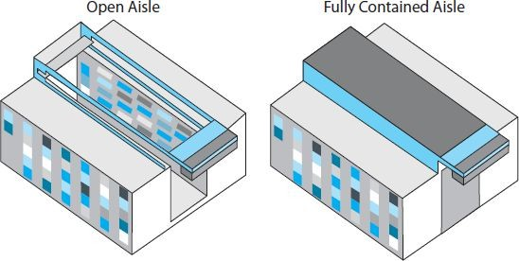
Air-Flow
The air flow rate m˙ required to cool a cabinet dissipating a power of Q is estimated from the following equation:
Q = m˙c_{p}ΔT
where c_{p} is the specific heat of air at constant pressure, and ΔT the air temperature rise.
Challenges: Higher power dissipation levels. Also, low static pressure near the bottom of cabinets may cause air from the hot aisle to mix with supply air, resulting in undesirable effects.

Slide 28
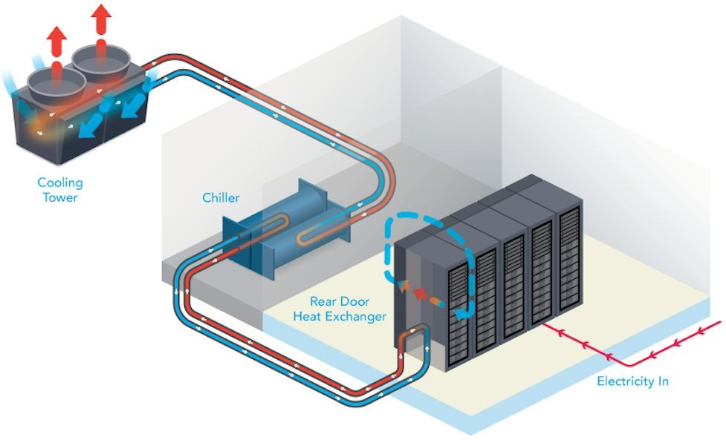
Hybrid-Cooling
Hybrid cooling involves a combination of multiple cooling schemes
Ex. Rear-Door Heat Exchangers (RDHEx) are used for cabinet power levels exceeding 20 kW.
Here heat exchangers circulate chilled water and cool the exiting air before releasing it into the hot aisle.
Availability of distributed chilled water infrastructure within the data center.

Slide 29
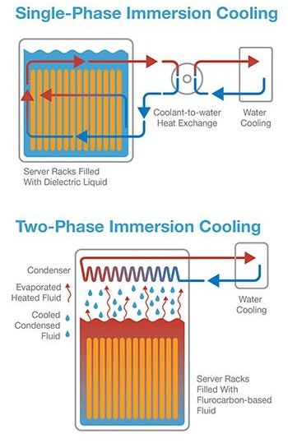
Immersion Cooling
System is submerged in a dielectric, electrically non-conductive fluid with high thermal conductivity.
Single-Phase: Heated liquid circulates through heat exchangers to remove heat from the system
Two-phase cooling: The fluorocarbon-based fluid boils to form vapour upon contact with hot spots in equipment. Vapour are condensed in a heat exchanger and recirculated into the cooling tank
Highly effective as liquid coolants absorb more heat and circulate more efficiently than air
Key benefits: Sustainability, Performance, Reliability, Cost
Coolant types: Deionized Water, Ethylene glycol, Propylene glycol, Mineral oil, and dielectric fluids (Shell Diala S4, XG Galden or Fluorinert)
https://www.lubrizol.com/Thermal-Management/Immersion-Cooling/Compuzol-Immersion-Fluid-Solution/Why-Custom-Fluid-Formulation-Matters-for-Your-Immersion-Cooling-System
29

Slide 30
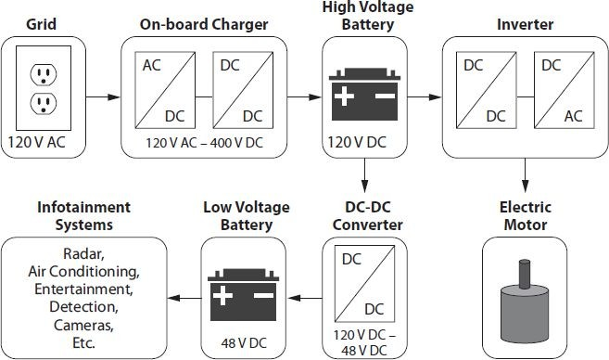
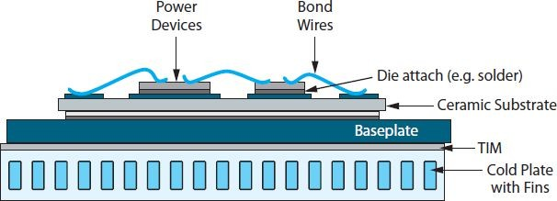
Conclusion : Phase - I Work and Future Work
Microelectronics systems are requiring more efficient cooling technologies as technologies scales down to achieve higher computational efficiency.
Packaging engineers must consider length scales, power dissipation, maximum acceptable temperatures for performance and reliability, and possible ambient temperatures when designing thermal management solutions.
Motivation behind heat generation issue to be explored in the Phase II presentation:
EVs require power electronics to convert and manage electrical energy.
Even with high efficiency, power electronics generate substantial heat (several kW).

Slide 31
References
White, F. Heat and Mass Transfer. Pearson: 1st ed., 1988.
Fundamentals of Device and Systems Packaging: Technologies and Applications, 2nd Edition ISBN: 9781259861550 Dr. Rao R. Tummala
Kadambi, V., and Abuaf, N. "An Analysis of the Thermal Response of Power Chip Packages." IEEE Transactions on Electron Devices, vol. 32, no 6, pp. 1024–1033, 1985.
Philips, R.J. Forced-Convection, Liquid-Cooled, Microchannel Heat Sinks. MIT Lincoln Labs, Technical Report 787, 1988.
Peterson, G. P. An Introduction to Heat Pipes: Modeling, Testing, and Applications. Hoboken, NJ: Wiley-Interscience, 1994.
Zuckerman, N., and Lior, N. Jet Impingement Heat Transfer: Physics, Correlations, and Numerical Modeling. Advances in Heat Transfer, vol. 39, pp. 565–631, 2006.
Narumanchi, S. V. J., Hassani, V., and Bharathan, D. Modeling Single-Phase and Boiling Liquid Jet Impingement Cooling in Power Electronics. National Renewable Engineering Laboratory, Technical Report, NREL/MP-540-38787, 2005.

Slide 32
Thank You

